Slide 1
Launch loads
Quasi-static loads
Shock loads
Sine vibrations
Random vibrations
Acoustic vibrations

Slide 2
Quasi-static loads
Caused by engine thrust
Increases as fuel decreases
Peaks at engine burnout
Between -1.5 and 5 g in longitudinal direction
Between -1.8 and 1.8g in lateral direction

Slide 3
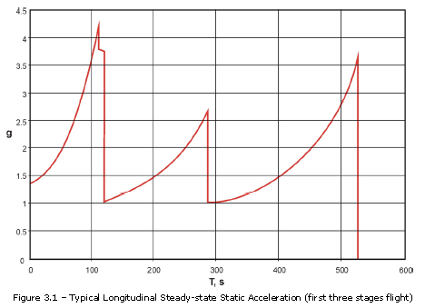
Quasi-static loads

Slide 4
Shock Loads
Caused by explosive events
High acceleration over a short period of time
Main sources are separation events
Also with deployment of appendages

Slide 5
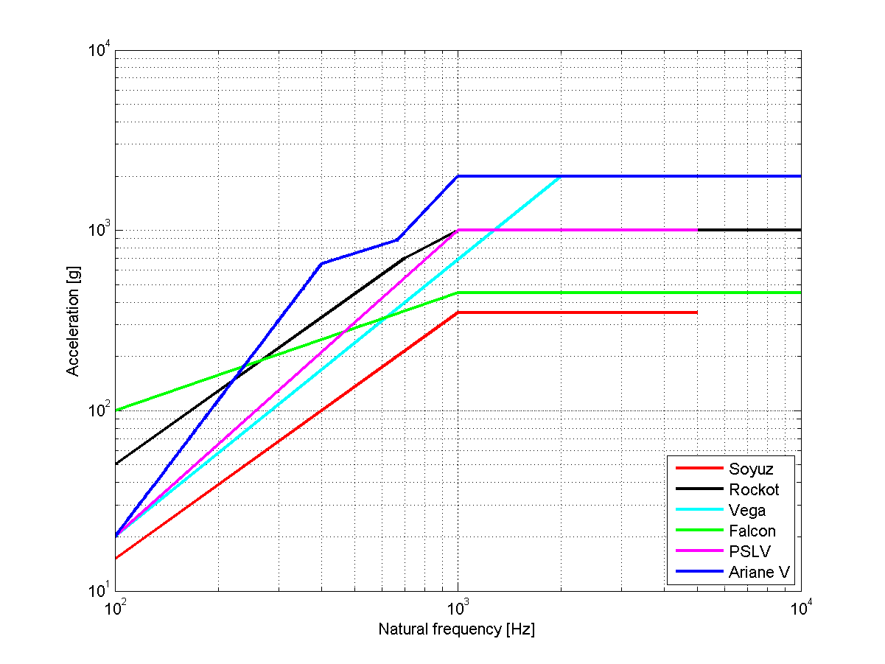
Shock loads

Slide 6
Sine vibrations
During atmospheric flight
Sources:
  Lift off
  Aerodynamic buffeting
  Oscillations in propulsion system
Avoid dynamic coupling
Between 0.3g and 1g

Slide 7
Random vibrations
Caused by propulsion system
Vibro-acoustic response of surrounding structure
Between 20 and 100 Hz

Slide 8
Acoustic vibrations
Up to 10 000 Hz
Sources:
  Acoustic noise from engines
  Aerodynamic turbulence
  On-ground venting system
Maximum 136 dB

